Slide 1
Course Module : Title
BCSE 4116:Software Process and Security

Slide 2
Module 1:Overview
This module introduces the fundamentals of web programming, focusing on server-side development, HTTP communication, and the basic architecture of web applications.

Slide 3
Module 1: Process Implementation and Change
Module 1 Overview: This module explores the methodologies for implementing and managing changes within software development processes.
Students will learn about change management frameworks, strategies, and tools necessary for effective process adaptation.

Slide 4
Module 1:Learning Outcomes
By the end of this module, the students should be able to:
Explain principles and frameworks for process implementation and change. (Knowledge)
Design a comprehensive process change plan tailored to specific organizational needs. (Skills)
Apply change management strategies to real-world scenarios to ensure smooth transitions. (Application)
Evaluate the impact of process changes on team performance and project outcomes. (Attitudes)

Slide 5
Objective 1: Principles and Frameworks for Process Implementation and Change
Introduction
Importance of process implementation and change in organizations
Need for structured principles and frameworks
Objective: To understand key principles and popular frameworks for change management

Slide 6
Key Principles of Process Implementation
Core Principles for Successful Change
Clear Objectives and Scope
Stakeholder Engagement
Communication
Training and Support
Pilot Testing
Feedback and Iteration
Monitoring and Evaluation

Slide 7
Principle 1 - Clear Objectives and Scope
Clearly defined goals, scope, and outcomes
Alignment with organizational objectives
Provides clear direction for the implementation team
Image: Visual representation of project scope or a timeline

Slide 8
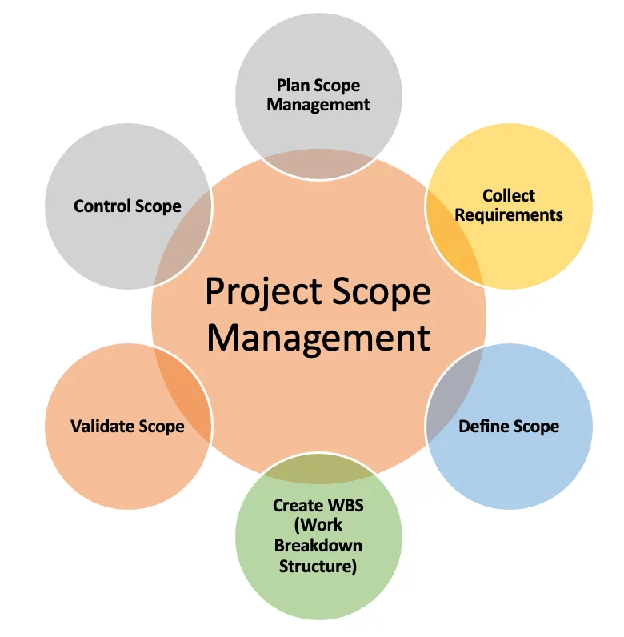
Principle 1 - Clear Objectives and Scope

Slide 9
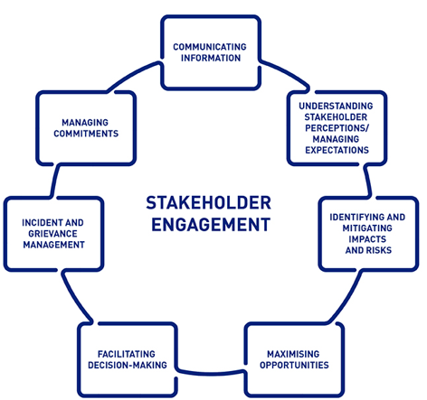
Principle 2 - Stakeholder Engagement
Title: Principle 2: Stakeholder Engagement
Bullet Points:
Early and continuous involvement of stakeholders
Reduces resistance and enhances buy-in
Gathers valuable input for smoother transitions
Image: A diagram showing stakeholder engagement

Slide 10
Popular Frameworks for Process Implementation
Title: Key Frameworks for Change
Bullet Points:
Kotter’s 8-Step Change Model
ADKAR Model
Lean Six Sigma
Change Management Lifecycle
Prosci Change Management Methodology

Slide 11
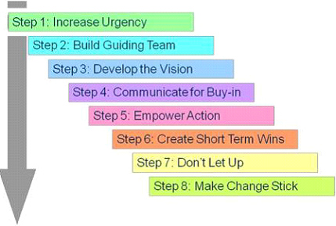
Framework 1 - Kotter’s 8-Step Change Model
Kotter’s 8-Step Change Model
Create Urgency
Form a Powerful Coalition
Create a Vision for Change
Communicate the Vision
Empower Action
Create Quick Wins
Build on the Change
Anchor the Changes

Slide 12
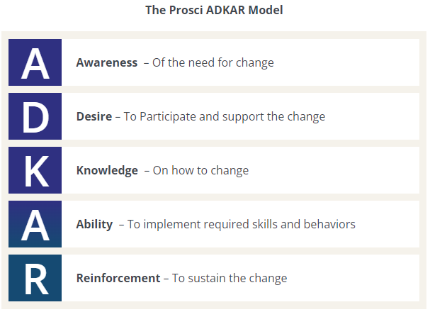
Framework 2 - ADKAR Model
ADKAR Model for Change Management
Bullet Points:
Awareness
Desire
Knowledge
Ability
Reinforcement

Slide 13
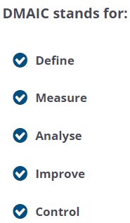
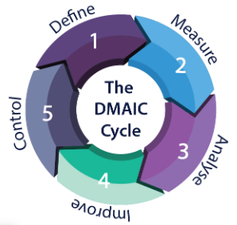
Framework 3 - Lean Six Sigma
Lean Six Sigma Framework
Define, Measure, Analyze, Improve, Control (DMAIC)
Focus on waste reduction and process improvement

Slide 14
Application of Principles and Frameworks
Assess Organizational Readiness: Evaluate the organization’s readiness for change using the principles and frameworks.
Develop a Change Plan: Use frameworks like Kotter’s 8-Step Model or ADKAR to guide the development of a change management plan.
Execute and Monitor: Implement the change according to the plan, using Lean Six Sigma or other methodologies to track progress and make adjustments.
Review and Sustain: Use feedback and iterative improvements to ensure the change is effective and sustained.

Slide 15
Conclusion
By understanding and applying these principles and frameworks, organizations can effectively manage process implementation and change, leading to successful and sustainable outcomes.

Slide 16
Comprehensive Process Change Plan
Designing a comprehensive process change plan tailored to specific organizational needs requires careful planning, stakeholder engagement, and a clear roadmap for implementation. Below is a step-by-step guide to designing such a plan

Slide 17
1. Identify the Need for Change
Assess Current Processes: Review existing processes and identify inefficiencies, bottlenecks, or areas that are not meeting organizational goals.
Determine Objectives: Define clear objectives for the change. What specific outcomes are desired? These could include cost reduction, increased efficiency, better compliance, or improved customer satisfaction.
Analyze Organizational Needs: Align the change objectives with the organization's strategic goals, considering factors such as market conditions, competition, customer needs, and technology advancements.

Slide 18
2. Engage Stakeholders
Identify Key Stakeholders: Involve people who will be affected by the change, including employees, management, customers, and suppliers. Their insights can provide valuable information about current challenges and areas for improvement.
Conduct Stakeholder Analysis: Understand how different stakeholders will be impacted and tailor communication and engagement strategies accordingly.
Establish a Change Leadership Team: Form a cross-functional team that will drive the change initiative. This team should have the authority to make decisions and the capacity to lead the process.

Slide 19
3. Develop a Change Vision and Strategy
Define the Change Vision: Create a compelling vision of what the future state will look like after the change. Ensure it is aligned with the organization's overall mission and goals.
Set Measurable Goals: Establish key performance indicators (KPIs) to measure the success of the change. These should be specific, measurable, achievable, relevant, and time-bound (SMART).
Outline the Change Strategy: Decide on the approach for implementing the change. Options may include incremental changes (gradual process adjustments) or transformational changes (overhauling processes or systems).

Slide 20
4. Conduct a Risk and Impact Assessment
Identify Potential Risks: Consider the risks involved in the change process, including resistance from employees, technology failures, or resource constraints.
Assess the Impact: Determine how the change will impact different areas of the organization, including workflows, team dynamics, and technology systems.
Develop Mitigation Strategies: Create contingency plans to address potential risks and minimize disruption.

Slide 21
5. Create a Detailed Implementation Plan
Define Roles and Responsibilities: Assign clear roles and responsibilities to team members involved in the change process.
Develop a Timeline: Create a timeline with milestones for key activities and deliverables. The timeline should be realistic and account for training, testing, and rollout phases.
Allocate Resources: Ensure that the necessary financial, technological, and human resources are available to support the change.

Slide 22
6. Communication and Training
Develop a Communication Plan: Ensure that all stakeholders are informed about the change, its benefits, and how it will affect them. Tailor communication to different audiences (e.g., employees, customers) using appropriate channels (e.g., emails, meetings, intranet).
Provide Training and Support: Develop training programs to equip employees with the skills needed to adapt to new processes or technologies. Offer ongoing support to help employees transition smoothly.

Slide 23
7. Implement the Change
Pilot the Change: If possible, pilot the changes in a small department or team before a full-scale rollout. Use the pilot to test the effectiveness of the process changes and make adjustments.
Full Rollout: Once the pilot is successful, roll out the changes organization-wide according to the implementation plan. Ensure that ongoing support and troubleshooting are available during the transition period.

Slide 24
8. Monitor and Measure Success
Track Progress: Monitor KPIs and other performance metrics to track the success of the change. Use data to determine if the change is meeting its objectives.
Collect Feedback: Regularly collect feedback from employees and other stakeholders to identify any ongoing challenges or areas for improvement.
Make Adjustments: Based on feedback and performance data, make necessary adjustments to ensure the changes are effective and sustainable.

Slide 25
9. Sustain the Change
Reinforce the Change: Use leadership and management to reinforce the new processes. Recognize and reward teams and individuals who embrace the changes.
Institutionalize the Change: Integrate the new processes into the organization's standard operating procedures (SOPs), documentation, and training materials to ensure long-term success.

Slide 26
10. Evaluate and Review
Post-Implementation Review: Conduct a formal evaluation of the change process after a set period (e.g., 6-12 months) to assess whether the change objectives have been met.
Continuous Improvement: Use the evaluation results to identify opportunities for continuous improvement and refinement of the processes.
By following this comprehensive process change plan, organizations can ensure a structured, collaborative, and strategic approach to implementing process changes that meet specific needs and objectives.

Slide 27
Change Management Strategies Applied to Real-World Scenarios
Scenario 1: Implementing a New Enterprise Resource Planning (ERP) System
Context: A mid-sized manufacturing company is adopting a new ERP system to streamline operations, manage inventory, and integrate finance and human resources.
Change Management Strategies:
Kotter’s 8-Step Model
Create Urgency: Communicate the need for the ERP system, highlighting inefficiencies with the current system, delays in inventory, and poor integration of departments.
Form a Powerful Coalition: Assemble a cross-functional team of department leaders (HR, IT, Finance) to drive change.
Communicate the Vision: Develop clear messaging on how the new ERP system will improve operations, and distribute this through emails, workshops, and departmental meetings.
Empower Action: Identify key obstacles (e.g., lack of IT skills), and provide training to overcome them.
Create Quick Wins: Implement the ERP system in small departments (e.g., HR) first to show early success.
Build on Change: Use the initial success to motivate further ERP adoption across departments like production and finance.
Anchor the Changes: Embed the ERP system into everyday processes, ensuring it becomes integral to the company’s operations.

Slide 28
Scenario 2: Organizational Restructuring in a Healthcare Organization
A hospital is undergoing restructuring to improve patient care by creating specialized departments, and some employees are being reassigned to new roles.
Change Management Strategies:
ADKAR Model
Awareness: Inform staff about why restructuring is necessary (e.g., improving patient care outcomes, streamlining services).
Desire: Build the desire for change by involving staff in the planning process and showcasing how new roles will lead to better career development.
Knowledge: Provide employees with the necessary training and information about their new responsibilities.
Ability: Conduct workshops and hands-on training sessions to equip staff with the skills they need for their new roles.
Reinforcement: Regularly check in on staff, providing additional support if necessary, and celebrate the improvements in patient care that the restructuring brings.

Slide 29
Scenario 3: Digital Transformation in a Retail Chain
Context: A retail chain is digitizing its operations by moving from in-store sales to e-commerce. This change requires new systems for online sales, digital marketing, and customer service.
Change Management Strategies:
Lean Six Sigma
Define: Identify the need to increase sales by transitioning to online platforms due to declining in-store foot traffic.
Measure: Analyze current sales performance, customer demographics, and the potential for digital sales.
Analyze: Identify root causes of current sales decline, such as limited online presence or outdated marketing strategies.
Improve: Implement an e-commerce platform, create an online marketing plan, and train staff to handle customer service via digital channels.
Control: Monitor the transition, track online sales, and continually improve the online customer experience.

Slide 30
Summary
Conclusion: Key Takeaways
Tailoring Strategies: Change management strategies need to be tailored to fit the specific context and needs of the organization.
Stakeholder Engagement: Ensuring stakeholder involvement at every step of the process is critical for minimizing resistance.
Communication & Training: Open communication and ongoing training help staff adapt to new changes more effectively, resulting in smoother transitions.
Monitoring & Feedback: Continuous monitoring and feedback loops ensure that the changes are working and allow for adjustments when necessary

Slide 31
Summary
Conclusion: Key Takeaways
Tailoring Strategies: Change management strategies need to be tailored to fit the specific context and needs of the organization.
Stakeholder Engagement: Ensuring stakeholder involvement at every step of the process is critical for minimizing resistance.
Communication & Training: Open communication and ongoing training help staff adapt to new changes more effectively, resulting in smoother transitions.
Monitoring & Feedback: Continuous monitoring and feedback loops ensure that the changes are working and allow for adjustments when necessary

Slide 32
The end
Thank you

